Slide 1


IGNITE
Pitch Deck
Milestone 4

Slide 2
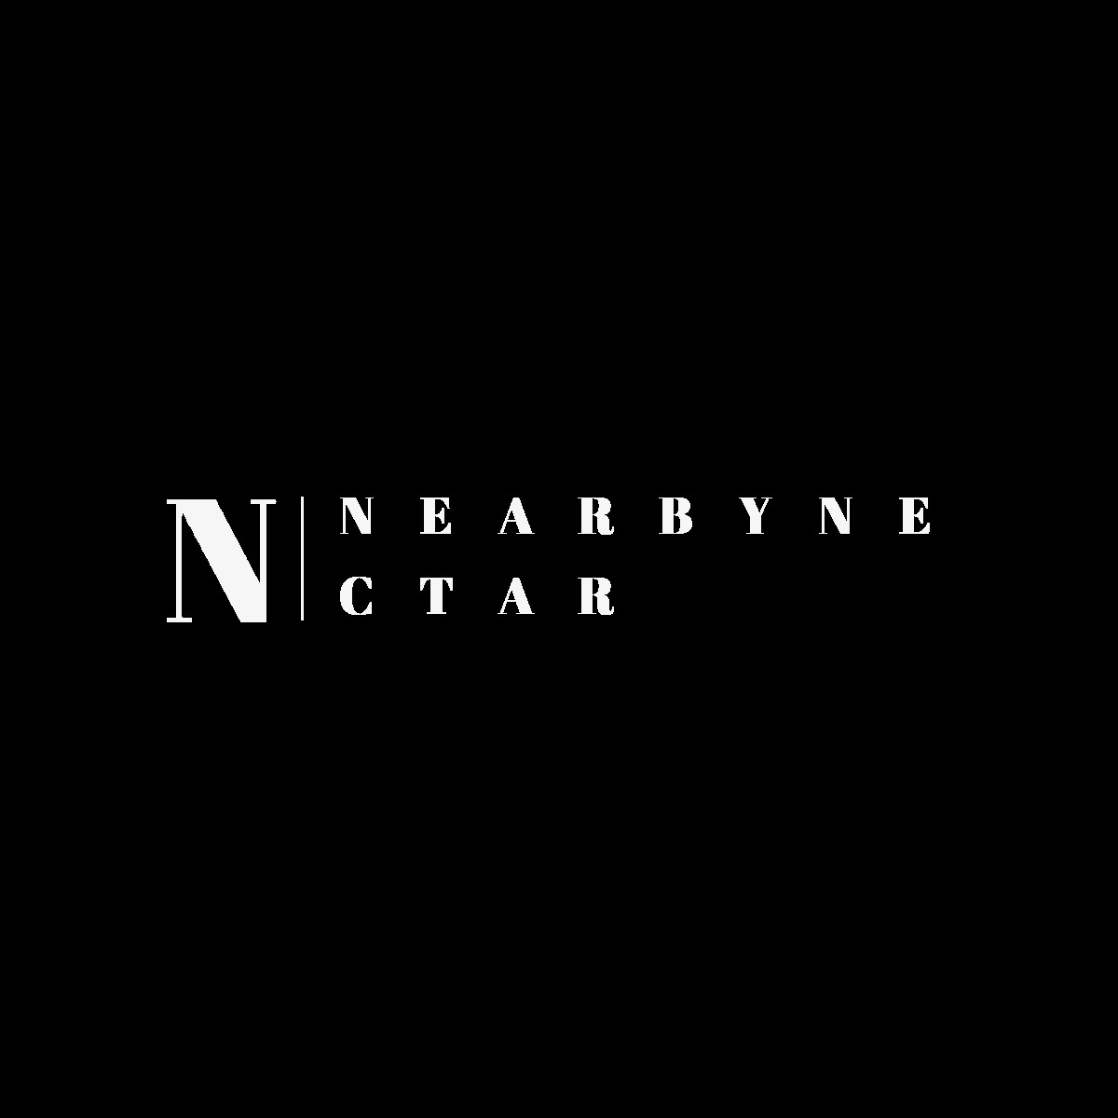


Who we are
Name of your Venture: NearbyNectar
Place your venture logo here
Why ?
Explain why do you want to pursue this Business Idea.
Identifying a gap in the market for locally made products and recognizing the potential for a platform to connect buyers with these unique offerings can be a strong motivation. Leveraging technology to bridge the gap between local sellers and a broader consumer base can be a powerful way to empower small businesses and artisans. The global trend towards supporting local businesses and a growing interest in unique, artisanal products can make this business idea particularly relevant and timely. Acknowledging the potential for digital platforms to transform traditional business models and enhance accessibility for both sellers and buyers. Clearly communicate your platform's policies to both sellers and buyers, including transaction fees, return policies, and any other relevant terms. Transparency builds trust, and trust is crucial for the success of an online marketplace.
What ?
Provide a brief on what does your venture do.
NearbyNectar is a platform that facilitates seamless transactions, connecting local artisans, businesses, and customers in a curated marketplace. The venture focuses on bringing a diverse selection of locally made products to the fingertips of consumers. Through this platform, buyers can discover and purchase unique items crafted by local artisans, while sellers have the opportunity to showcase their products to a broader audience. NearbyNectar aims to create a vibrant online marketplace that celebrates the craftsmanship and stories behind locally produced goods, fostering a sense of community and sustainability in the process. By promoting locally made products, the platform contributes to sustainable practices, reduces the environmental impact of transportation, and offers consumers unique and authentic items.
How ?
Explain how your venture solves the problem and make its revenue.
NearbyNectar provides a platform for local artisans and businesses to showcase their products to a broader audience, overcoming the limitations of traditional local markets. NearbyNectar provides a platform for local artisans and businesses to showcase their products to a broader audience, overcoming the limitations of traditional local markets. NearbyNectar can charge a small transaction fee on each successful sale conducted on the platform. This revenue stream is a percentage of the total transaction value. Sellers may have the option to pay for premium listings, gaining higher visibility for their products on the platform. This can include featured placements, better search rankings, or highlighted product categories. Offer paid advertising opportunities for sellers who want to boost the visibility of their products through targeted promotions, sponsored listings, or other advertising channels within the platform.

Slide 3
Problem/Opportunity
Place your logo here
CONTEXT When does the problem occur? | PROBLEM What is the root cause of the problem? | ALTERNATIVES What do customers do now to ﬁx the problem?
CUSTOMERS Who has the problem most often? | EMOTIONAL IMPACT How does the customer feel? | ALTERNATIVE SHORTCOMINGS What are the disadvantages of the alternatives?
 | QUANTIFIABLE IMPACT What is the measurable impact (include units)?
Local artisans often struggle to gain visibility beyond their immediate community or traditional markets. Lack of an online presence and limited marketing resources make it challenging for artisans to reach a broader audience. Consumers face difficulties in discovering and purchasing locally made products. Traditional local markets may not be easily accessible, and consumers may be unaware of the diverse range of products available in their local area. There is a lack of connectivity between local businesses, artisans, and potential customers.
The root cause of the problem is lack of digital literacy and resources among local artisans, preventing them from establishing and maintaining an effective online presence. Lack of a unified platform and communication channels for local businesses, hindering collaboration and making it challenging for buyers to find specific products. Inadequate resources, including marketing budgets and technology infrastructure, that limit the ability of local businesses to compete with larger, multinational corporations on a global scale.
Customer can visit the NearbyNectar platform to explore a curated selection of locally made products. By actively engaging with the platform, customers can discover unique items and support local artisans and businesses. They can choose to make purchases through NearbyNectar for locally made products. Opting for local purchases contributes to the growth of local economies and helps address the challenges faced by local artisans and businesses. They can share feedback on the platform, including product reviews, suggestions, and any issues encountered.
Local Artisans and Small Businesses: Limited visibility, especially beyond their immediate communities. Lack of resources and access to online platforms makes it challenging for local artisans and small businesses to showcase and sell their products to a broader audience.
Consumers Seeking Local Products: Difficulty in discovering and purchasing locally made products. Limited awareness of the diverse range of products available locally, and traditional markets may not be easily accessible or convenient for all consumers.
Local Markets and Communities: Lack of connectivity and a centralized platform for local businesses. Without a centralized platform, local markets may struggle to effectively connect buyers with sellers, hindering the growth and vibrancy of local economies.
Customers may feel a sense of excitement as they explore a diverse and curated selection of locally made products. A strong emotional connection may arise as customers learn about the stories, traditions, and craftsmanship behind each product. Customers may feel empowered to make a positive impact on their local community by supporting local businesses and artisans.
Local artisans and businesses may struggle to gain visibility beyond their immediate community or physical market. Customers may find it inconvenient to physically visit different local markets to discover and purchase products. Large-scale global platforms often prioritize mass-produced goods over locally crafted items, making it challenging for local businesses to stand out. Global platforms may lack the community-focused features and connections that a local-centric platform like NearbyNectar provides. While social media and general online marketplaces exist, they may lack curation, making it difficult for users to discover a curated selection of locally made products. Trust and security concerns may arise when making transactions through various social media platforms. Direct selling may limit the reach of local businesses to a specific geographic area, missing out on potential customers from other regions.
Sales Revenue: the measurement would be the total revenue generated through transactions on the platform and the units could in 10 Lakhs as a starting.
Number of Transactions: the measurement would be the total number of purchases made on NearbyNectar. The units of transaction could be 10000.

Slide 4
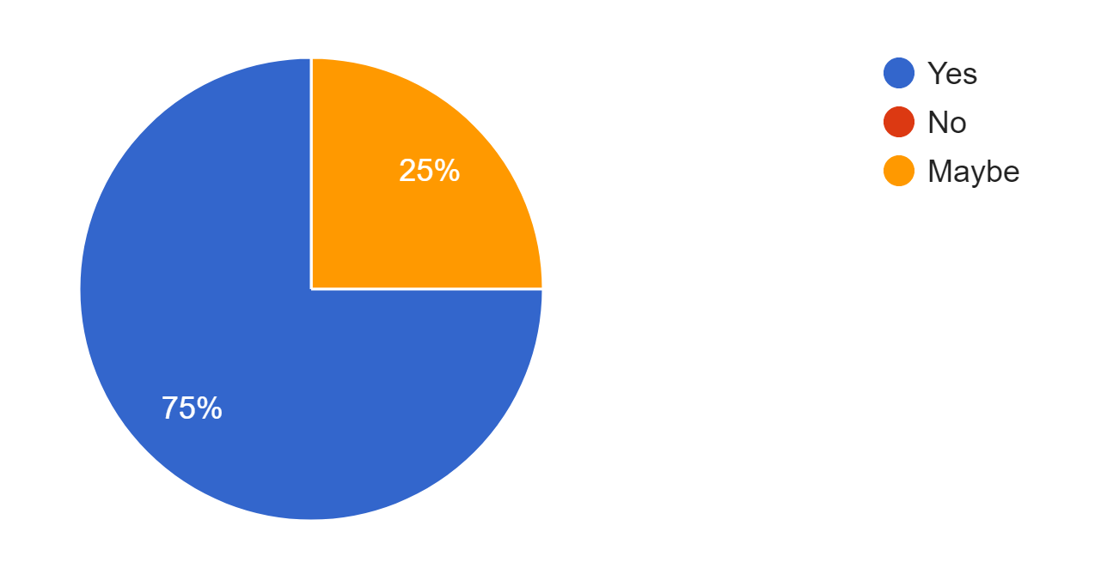

Problem Interviews And Surveys Results
Place your logo here
How many customers did you interview?
What was the interview mode?
How many of them agree this is a problem and wants a solution?
How many of them said they don't need a new solution?
-100
-Google Forms
-75% people agree
The aim of this slide is to capture the customer responses to substantiate and validate the problem your venture is solving. Present result analysis of the problem interviews conducted with your potential customers in graphical representation.
-No one disagreed but 25% think maybe it requires a solution
and vice-versa

Slide 5
Market Size Estimation
TAM
SAM
SOM
How to calculate market size?
Total Addressable Market (TAM): 10 Lakhs (Estimated total market size for locally made products in [Dehradun]).
Serviceable Addressable Market (SAM): 5 Lakhs
NearbyNectar's Target Market Share: 30%.
Estimated Market Size: 1 Crore.
Revenue Streams Breakdown:
Transaction Fees: 3 Lakhs
Premium Listings: 5 Lakhs
Subscriptions: 2 Lakhs
Growth Projection: 30% annual growth over the next [3 years].
Assumptions and Risks: Assuming a certain percentage of the target market will adopt NearbyNectar within a specified time frame. Assumes a steady and realistic growth rate based on market research and user acquisition strategies. Assumes a certain level of competitiveness in the market and estimates NearbyNectar's ability to capture a share considering competition.
.

Slide 6
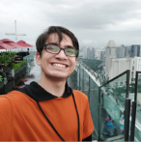
Customer Persona
Adventurous
Empathetic
Resilient
Goals
Priyanshu wants to explore and find one-of-a-kind products crafted by local artisans, enriching her lifestyle with unique and meaningful possessions. Priyanshu is passionate about supporting her local community. She seeks ways to contribute to the success of local businesses and artisans to help sustain their livelihoods. Priyanshu is environmentally conscious and aims to minimize her carbon footprint. She looks for sustainable alternatives and supports products that are locally made to reduce transportation-related emissions. Priyanshu wants to be part of a community that shares her interests. She seeks interactions with fellow enthusiasts, exchanging recommendations and experiences related to locally made products.
Ethos: Committed to reducing their carbon footprint and fostering a sustainable lifestyle.
Frustrations
Difficulty in discovering a diverse range of locally made products due to limited visibility on the platform. Implement enhanced search and recommendation features to ensure a wide array of products are easily accessible to users like Priyanshu. Incomplete or inconsistent information about the products and their makers. Encourage sellers to provide comprehensive product details and stories. Implement quality control to ensure consistency in product information. Limited opportunities to connect directly with local artisans and learn more about their creative processes.
Age: 20
Occupation: Btech Student
Location: Dehradun
Personality
Bio
Name: Priyanshu Tandon
Motivation:
Reduce carbon footprint through eco-friendly commuting.
Save on transportation costs through shared rides.
Contribute to a more sustainable and connected campus environment.
Notes:
Time: 7 mins
Get students to brainstorm on the customer persona and VPC

Slide 7
Value Proposition Canvas
.
What do you offer that makes the customers happy?
A curated selection of locally made products that are unique, authentic, and carry the personal touch of local artisans. Customers find joy in discovering one-of-a-kind items that tell a story and have cultural significance. Another offering are Detailed artisan profiles and narratives that allow customers to connect with the creative minds behind the products. Building a personal connection with artisans and understanding their stories adds depth and meaning to the shopping experience.
What would make the customer happy? What do the clients want when facing the problem?
Discovery of Unique and Meaningful Products:
Customer Happiness: Customers want to discover products that are unique, meaningful, and tell a story.
NearbyNectar Solution: Curates a diverse selection of locally made products, ensuring each item has cultural significance and personal meaning.
Support for Local Artisans and Businesses:
Customer Happiness: Customers want to contribute to the success and sustainability of local artisans and businesses.
NearbyNectar Solution: Provides a platform for artisans to showcase their work, fostering a direct connection between customers and the local creative community.
What do the clients do (actions) when facing the problem?
Clients often turn to online search engines to find locally made products or solutions to their specific needs because Online searches provide a quick and accessible way to discover platforms, marketplaces, or information related to locally made products. Clients may explore existing online marketplaces or e-commerce platforms in the hope of finding a diverse range of locally crafted items because established marketplaces are often the first go-to for shoppers, offering a wide selection, but the challenge might be in finding truly unique and local products.
GAIN CREATORS
FIT
GAINS
PRODUCT/
SERVICE
JOBS
What is the product or service that you are offering?
Online Marketplace for Locally Made Products: NearbyNectar serves as a central hub where local artisans and businesses can showcase and sell their unique, handmade products.
Curated Selection of Unique Products: The platform offers a curated collection of locally made products, ranging from handmade crafts, artwork, clothing, home goods, and more.
Personalized Search and Recommendations: The platform offers advanced search and recommendation features that tailor product suggestions based on individual preferences.
PAIN KILLERS
PAINS
Which features of your offering relieve the customer's pains?
Pain Relieved: Overwhelm and difficulty in finding unique, locally made products in a vast market.
How it Helps: NearbyNectar curates a selection of authentic items, simplifying the process of discovering distinctive products without the need to sift through an extensive range.
What are the pains of the clients when facing the problem?
Clients struggle to discover a diverse range of locally made products due to limited visibility in traditional marketplaces or online searches because limited visibility makes it challenging for clients to explore a wide array of unique and local items. Clients face difficulties in discerning authentic locally made products from mass-produced or generic items because the authenticity of products may be obscured, leading to uncertainty about the origin and craftsmanship.

Slide 8
Solution
Describe your Solution:
NearbyNectar is an innovative online platform designed to seamlessly connect local artisans, businesses, and customers, creating a vibrant marketplace for locally made products. Our solution is built around the idea of bringing the unique charm of local craftsmanship directly to the fingertips of users like you, providing a curated selection of authentic and meaningful items.
The details of our offering consist of:
Curated Product Selection: We curate a diverse and carefully selected range of locally made products, ensuring that each item has a story, a touch of craftsmanship, and a connection to the local community.
Artisan Profiles and Stories: Dive into the world of local artisans through detailed profiles and stories. Learn about the creative processes, inspirations, and the individuals behind the products you love.
User-Friendly Interface: Our platform boasts a user-friendly interface, making navigation and exploration effortless. Discovering unique products and engaging with local artisans is just a click away.
Secure Transactions: We prioritize the security of your online transactions. Our platform integrates secure payment gateways, providing a safe and trustworthy environment for buying and selling.
Community Engagement: Foster connections with like-minded individuals who share a passion for locally made products. Join community forums, discussions, and social media groups to engage with fellow enthusiasts and artisans.
Artisan Interaction Opportunities: Engage directly with local artisans through live Q&A sessions, virtual workshops, and interactive features that bring you closer to the creative process.
Regular Updates and Promotions: Stay informed about new arrivals, promotions, and exclusive offers from your favorite local artisans.
List the Benefits of Your solutions
Access to Unique and Authentic Products: Discover a curated selection of locally made products that are unique, authentic, and tell a story. Each item on NearbyNectar reflects the craftsmanship and cultural richness of the local community.
Support Local Artisans and Businesses: Contribute to the growth and sustainability of local economies. By purchasing from NearbyNectar, you directly support local artisans and businesses, helping them thrive.
Enhanced Visibility for Local Artisans: Local artisans gain increased visibility beyond their immediate communities. NearbyNectar provides a platform for artisans to showcase their talents to a broader audience.
Convenient Online Shopping Experience: Enjoy the convenience of shopping for locally made products from the comfort of your home. Our user-friendly interface ensures a seamless and enjoyable online shopping experience.
Connection with Artisans' Stories: Immerse yourself in the stories behind the products. Each artisan has a profile and narrative, allowing you to connect with the creative process and understand the cultural significance of the items you purchase.
Regular Updates and Exclusive Offers: Stay informed about new arrivals, promotions, and exclusive offers from your favorite local artisans. NearbyNectar keeps you in the loop with regular updates, ensuring you have access to the latest offerings.
Environmental Impact and Sustainability: Contribute to environmental sustainability by choosing locally made products with a lower carbon footprint. NearbyNectar is committed to promoting eco-friendly practices and products.
Notes:
Evaluation Criteria for slides 8 and 9
Check the following on the correctness of VPC: a. Have you identified the correct pains & gains; pain relievers & gain creators (2 marks) b. Have you identified the correct Jobs-to-be-done? (1 mark) c. Are the pain relievers addressing the customer pains? (1 mark) d. Have you identified the right value proposition so that the solution makes the customer's life better? (1 mark)

Slide 9
Competition Analysis
Place your logo here
Benefits | Competitor 1 | Competitor 2 | Competitor 3 | Competitor 4 | Your Venture
Product | Jodhpur Homes | The Décor Remedy | Fleck | Wooden Street | NearbyNector
Price | 15100 | 13649 | 39830 | 19900 | 10100
Branding channels | Social Media | Advertising | Content Marketing | Influencer marketing | Social Media
Packaging | Primary | Tertiary | Primary | Secondary | Primary
Market reviews | Less Durable | Cheap | Very Expensive | Expensive | Cheap
UVP | Elevate your living space with the exquisite charm of our Round Solid Wood Coffee Table. | We thrive on building hassle-free experiences for you, right from selecting the product to having delivered to your home. | Wipe clean with a dry cloth, always use a coaster to avoid rings. | Furniture Bonded with Love | Connecting You to Local Treasures

Slide 10
Lean Canvas
Place your logo here
PROBLEM
Selling good product with good quality and affordable price.
EXISTING ALTERNATIVES
Etsy
Handmade at Amazon
ArtFire
Big Cartel
Aftcra
Zibbet
SOLUTION
Local Shops Hub: Your Neighborhood, Online. Explore, order, and support local businesses easily. A unified platform bringing your community's shops to your fingertips.
UNIQUE VALUE PROPOSITION
"Unleash Local Delights Online: Discover and order from your neighborhood's diverse array of shops at your fingertips, connecting communities through convenience and supporting local businesses with every click
HIGH-LEVEL CONCEPT
Transforming Local Commerce: A unified online platform bringing together the richness of neighborhood shops, providing customers with the ease of ordering from local favorites and empowering small businesses to thrive in the digital era
UNFAIR ADVANTAGE
Community Trust Builder
Innovative Supply Chain Integration
Localized Marketing Mastery
4.Exclusive Local Inventory
CUSTOMER SEGMENTS
Locals wanting easy access to nearby shops.
Small Businesses aiming to boost their online presence.
Community Supporters passionate about local commerce.
Tech-Savvy Shoppers preferring digital convenience.
EARLY ADOPTERS
Techy Locals: People into digital solutions for daily tasks.
Local Business Explorers: Small business owners keen on expanding online.
Community Supporters: Folks actively backing local businesses.
Online Shoppers: Tech-savvy consumers who love online convenience.
KEY METRICS
Order Volume
Customer satisfaction
Number of Partnered Shops
CHANNELS
Haven daily uses products markets and sells its through a variety of channels, including online listings, print advertising, and word-of-mouth.
COST STRUCTURE
Technology: Website development, hosting, maintenance.
Marketing: Digital and offline marketing efforts.
Operations: Customer support, logistics, shipping.
Legal and Compliance: Legal services, insurance.
REVENUE STREAMS
Transaction Fees: Charge a percentage on each sale.
Subscription Models: Premium plans for artisans.
Featured Listings: Fees for prominent product placement.
Affiliate Marketing: Commission for sales via partnerships.
Partnerships: Collaboration fees with local businesses.

Slide 11
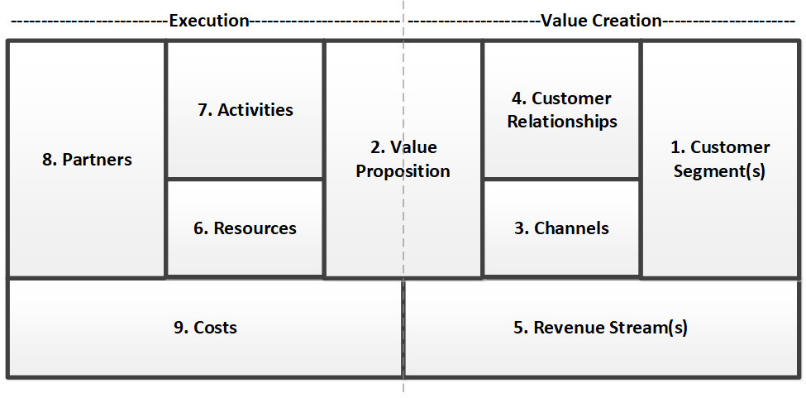
Lean Canvas
Place your logo here
Business Model
Customer Segments: This component identifies the various groups of people or organizations that the business aims to serve. Understanding and targeting specific customer segments allow the company to tailor its products or services to meet the unique needs of each group.
Value Proposition: The value proposition articulates the distinctive value a product or service provides to its customers. It highlights the problem it solves, the benefits it offers, and why it stands out from the competition.
Channels: Channels represent the avenues through which a business delivers its value proposition to customers. This component involves the distribution and communication strategies, including sales channels, marketing, and delivery methods.
Customer Relationships: This component outlines the type of relationship a company establishes with its customers. Whether it's through personal assistance, automated services, or community engagement, understanding and fostering positive customer relationships is crucial for long-term success.
Revenue Streams: Revenue streams detail how the business generates income. This can include various sources such as sales, subscriptions, licensing, or advertising. Identifying and diversifying revenue streams is key to financial sustainability.
Key Resources: Key resources encompass the assets and capabilities necessary for the business to operate effectively. This could include physical, intellectual, human, or financial resources that contribute to the value creation process.
Key Activities: Key activities are the essential tasks and processes that a business must perform to deliver its value proposition, reach customers, and sustain operations. These activities align with the company's overall strategy and goals.
Key Partnerships: Partnerships involve collaborations with external entities that contribute to the business's success. This can include suppliers, strategic alliances, or joint ventures that enhance capabilities, reduce risk, or improve efficiency.
Cost Structure: The cost structure outlines the major expenses incurred while operating the business. Understanding the costs associated with key resources, activities, and partnerships is crucial for effective financial management and sustainability.

Slide 12
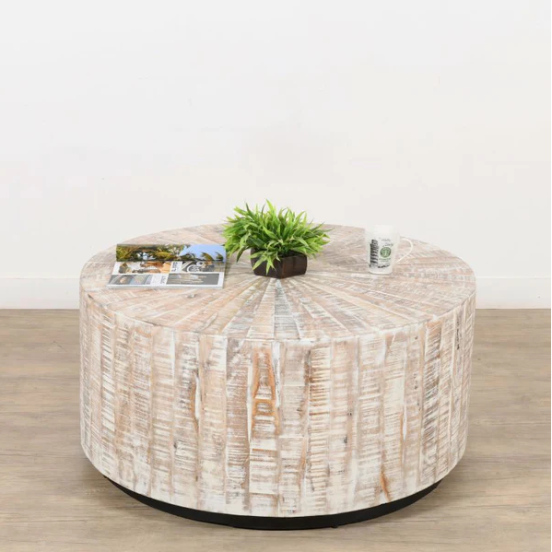
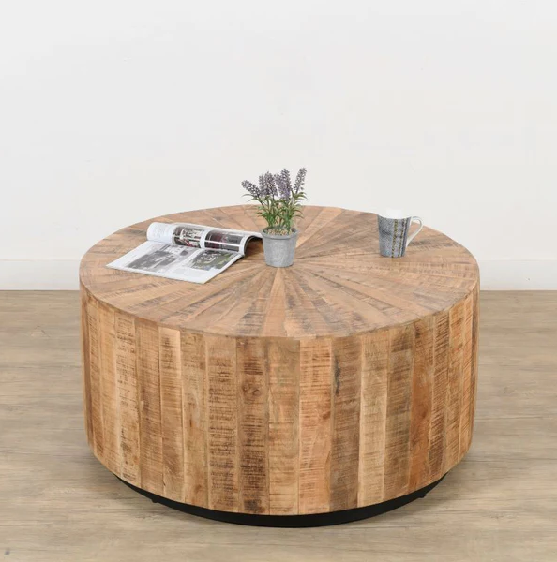
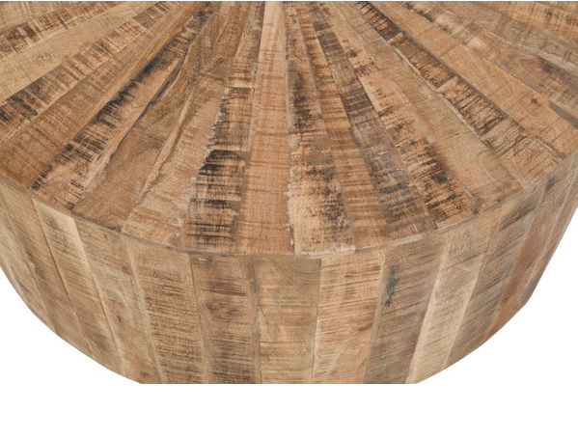
MVP
Place your logo here
Provide Full product/service description
For example one of our project is Wooden Coffee Table. So here are product description:
Elevate your living space with the exquisite charm of our Round Solid Wood Coffee Table. Designed to be the heart of your living room, this masterfully crafted piece captures the essence of both form and function. Made from the finest quality solid wood, it's a testament to the artistry of woodworking and a celebration of natural elegance

Slide 13
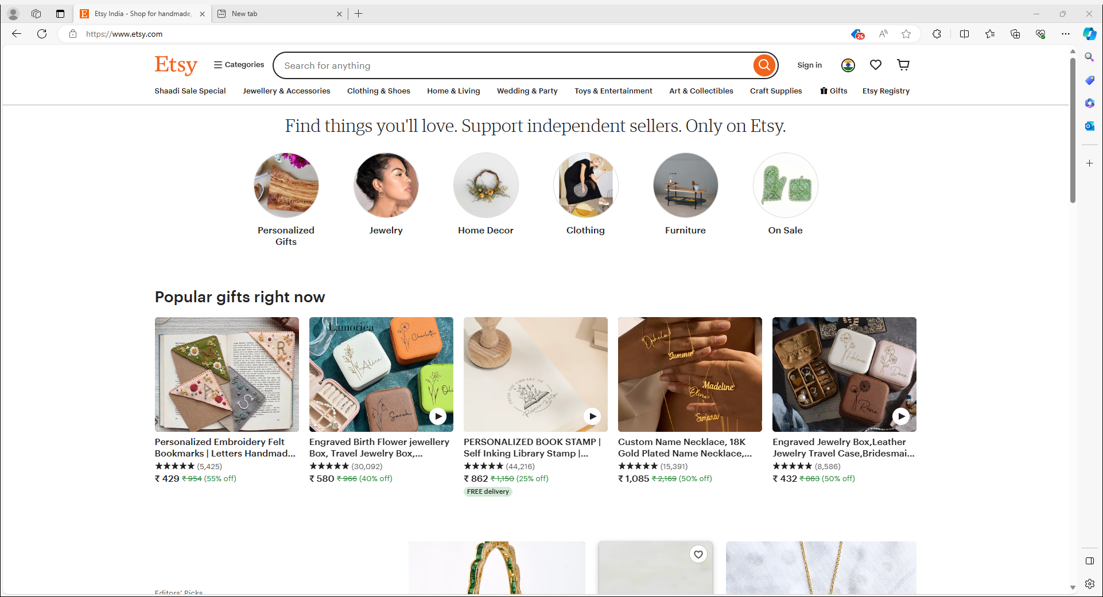
MVP
Place your logo here
Insert a picture of the prototype

Slide 14
MVP Validation
What is your MVP ?
The Local Artisanal Marketplace's MVP likely includes essential features for users to browse, discover, and connect with local artisans and their handmade products, with basic personalization tools.
Conclusion:
How long will we test this MVP?
MVP testing phases may last a few weeks to a few months to gather sufficient data and
insights from users, enabling refinement and improvement before a full-scale launch.
Persevere
Pivot
Who is our target audience for the test? How many of them? The aim is to have a large enough
sample size to identify patterns and trends in user behavior and preferences.
Not conclusive
How will we get to that audience?
We'll reach our target audience for MVP testing through a multi-channel strategy, including online marketing, social media, email campaigns, and potential partnerships with artisan comm.
Results of Test:
Realizations / Insights:
Did enough customers buy? Why or why not?
factors influencing success include product appeal, marketing effectiveness, user
experience, and pricing strategy.
The sense of community is a powerful motivator for both artisans and customers. NearbyNectar's community engagement features have not only fostered connections but have become a driving force behind platform growth. The shared enthusiasm for locally made products creates a vibrant and supportive ecosystem. Customers value the personal stories and narratives behind the products. Artisan profiles and stories have become a cornerstone of NearbyNectar's success. Customers are not just purchasing products; they are investing in the stories, experiences, and passion that artisans pour into their creations. Direct interaction with artisans is a key driver of customer loyalty. Live Q&A sessions, workshops, and interactive features have created a unique bond between customers and artisans. This direct engagement not only enhances the shopping experience but also fosters a sense of connection that goes beyond a transaction. Trust is paramount in online transactions, especially in the realm of locally made products. The emphasis on secure and seamless transactions has contributed significantly to customer confidence. A reliable and trustworthy platform is the foundation for sustainable growth and positive user experiences.
Did customers pay the price we expected? Why or why not?
factors influencing this include perceived value and the effectiveness of pricing strategies.
Did customers come back to our product or show interest in doing so? Why or why not?
For the most current information on customer retention and interest, it's recommended to check the Local Artisanal Marketplace's user engagement metrics, customer feedback, or contact their customer support for insights.
Did customers recommend our product to others or evangelize about it? Why or why not?
For the latest insights on customer recommendations or evangelism, it's recommended to check customer reviews, testimonials, or the Local Artisanal Marketplace's communication channels for any indications of customer advocacy.
Notes:
Evaluation Criteria for slides 12 to 14
Check the following on MVP? 1. Does it look credible and showcasable? Add a picture/video of the MVP? (3 marks) 2. Have you validated the product benefits and the price with real customers? Add the MVP interview records in a Google drive and add to the PPT. (1 + 1 marks)

Slide 15
Sales Plan
Place your logo here
Customer Sales Funnel
Customer Acquisition Plan
1 | 2 | 3 | 4 | 5
Target Customer Segment (Type) | Target Customer Segment (Number) | Channels to be used to attract the target customer segment | Estimated number of leads | Estimated cost to convert these leads to actual customers
1 | 2 | 3 | 4 | 5
Target Customer Segment (Type) | Target Customer Segment (Number) | Channels to be used to attract the target customer segment | Estimated number of leads | Estimated cost to convert these leads to actual customers
Buying Enthusiasts | High | Social Media, Antique Events | 5,000 | 15,000
Connoisseurs | Moderate | Exclusive Religious Clubs, Events | 2,500 | 20,000
Gift Shoppers | Moderate | Online Gift Platforms, Events | 3,000 | 12,000
Educational Events Attendees | High | Webinars, Collaborations | 4,000 | 18,000
Event Planners | Moderate | B2B Networking, Event Platforms | 2,500 | 25,000
Online Communities | High | Forums, Social Media Groups | 6,000 | 10,000
General Wine Consumers | High | E-commerce Platforms, SEO | 8,000 | 22,000
Target market is comprised of sophisticated and discerning wine enthusiasts who appreciate the finer aspects of wine culture.
Those who attend wine tastings, vineyard tours, and other wine-related events, showcasing an interest
Someone who enjoys the taste of fine and also values the cultural and historical aspects
Individuals who actively seek to expand their knowledge of wine, appreciate the craftsmanship of winemaking,
Notes:
Evaluation Criteria for slide 20 to 22
1. Does the venture have a Sales projections sheet with monthly sales targets and customer funnel defined for the next one year? (2 marks) 2. Does the venture have an active social media presence, such as FB, Instagram, LinkedIn? (1 mark) 3. Do you have a well-thought out brand name, logo, and a Positioning statement? (1 mark) 4. Have you made an actual sale? (1 mark)

Slide 16
FINANCIAL PLAN
Start-up Costs
Total Equipment Costs | 15,000
Marketing and Promotional Costs | 10,000
Supplies and Raw materials | 5,000
Stationery and office supplies | 1,000
Working capital | 10,000
Total Starting Operations Costs | 26,000
Equity investment (by Team) | 50,000
Loans (from College or Others) | 0
Total Start-Up Capital | 50,000
28,000 | To cover start-up costs and working capital for the first six months.
Total Set-Up Costs | 53,000
Expense/Source | Cost/Amount
Consultant Fees (Accountants, Lawyers, etc.) | 5,000
Business Registration fees | 2,500
Website Related (Domain registration, Website setup, etc.) | 1,000
Licenses | 2,000
Other Start-Up Costs | 1,500
Total Start-Up Expenses | 12,000
Other equipment | 2,000
Notes:
Evaluation Criteria for slide 24
1. Have you done their Unit Economics and come up with CAC, CLV, ARPU, Net and Gross Profit? (1 mark) 2. Do you have a plan on how to reduce their CAC and churn rate, and increase their CLV, ARPU, and Net Profit Margin? (2 marks) 3. Is the capital asked for as per the Funding plan in line with the business? (1 mark) 4. How long will it take you to return the investment? (1 mark)

Slide 17
Forecast P&L
Item | Jan | Feb | Mar | Apr | May | Jun | Jul | Aug | Sep | Oct | Nov | Dec | Total
Sales
Cash sales | 10,000 | 12,000 | 14,000 | 16,000 | 18,000 | 20,000 | 22,000 | 24,000 | 26,000 | 28,000 | 30,000 | 32,000 | 252,000
Collections from accounts receivable | 5,000 | 6,000 | 7,000 | 8,000 | 9,000 | 10,000 | 11,000 | 12,000 | 13,000 | 14,000 | 15,000 | 16,000 | 120,000
Total sales | 15,000 | 18,000 | 21,000 | 24,000 | 27,000 | 30,000 | 33,000 | 36,000 | 39,000 | 42,000 | 45,000 | 48,000 | 372,000
Cost of goods sold
Cost of wood | 10,000 | 12,000 | 14,000 | 16,000 | 18,000 | 20,000 | 22,000 | 24,000 | 26,000 | 28,000 | 30,000 | 32,000 | 252,000
Gross profit | 5,000 | 6,000 | 7,000 | 8,000 | 9,000 | 10,000 | 11,000 | 12,000 | 13,000 | 14,000 | 15,000 | 16,000 | 120,000
Operating expenses
Salaries and consultant fees | 2,000 | 2,000 | 2,000 | 2,000 | 2,000 | 2,000 | 2,000 | 2,000 | 2,000 | 2,000 | 2,000 | 2,000 | 24,000
Marketing and promotion | 1,000 | 1,000 | 1,000 | 1,000 | 1,000 | 1,000 | 1,000 | 1,000 | 1,000 | 1,000 | 1,000 | 1,000 | 12,000
Utilities | 500 | 500 | 500 | 500 | 500 | 500 | 500 | 500 | 500 | 500 | 500 | 500 | 6,000
Transportation | 250 | 250 | 250 | 250 | 250 | 250 | 250 | 250 | 250 | 250 | 250 | 250 | 3,000
Office supplies | 100
Notes:
Evaluation Criteria for slide 24
1. Have you done their Unit Economics and come up with CAC, CLV, ARPU, Net and Gross Profit? (1 mark) 2. Do you have a plan on how to reduce their CAC and churn rate, and increase their CLV, ARPU, and Net Profit Margin? (2 marks) 3. Is the capital asked for as per the Funding plan in line with the business? (1 mark) 4. How long will it take you to return the investment? (1 mark)

Slide 18
Financial Projections
Place your logo here
Year | Number of sales | Value of each sale | Total Revenue | Capital costs | Other expenses | Earnings (EBDITA)
Year 1 | 10,000 | 100 | 1,000,000 | 500,000 | 200,000 | 300,000
Year 2 | 12,000 | 110 | 1,320,000 | 400,000 | 220,000 | 700,000
Year 3 | 15,000 | 120 | 1,800,000 | 300,000 | 240,000 | 1,260,000
Year 4 | 18,000 | 130 | 2,340,000 | 200,000 | 260,000 | 1,880,000
Year 5 | 21,000 | 140 | 2,940,000 | 100,000 | 280,000 | 2,560,000
Notes:
Evaluation Criteria for slide 24
1. Have you done their Unit Economics and come up with CAC, CLV, ARPU, Net and Gross Profit? (1 mark) 2. Do you have a plan on how to reduce their CAC and churn rate, and increase their CLV, ARPU, and Net Profit Margin? (2 marks) 3. Is the capital asked for as per the Funding plan in line with the business? (1 mark) 4. How long will it take you to return the investment? (1 mark)

Slide 19
Unit Economics
Year | CAC | CLV | ARPU | Gross Profit | Gross Profit Margin | Operating Costs | Operating Profit
Year 1 | 50 | 100 | 10 | 5 | 50% | 2 | 3
Year 2 | 45 | 110 | 11 | 6.50 | 59% | 2.20 | 4.30
Year 3 | 40 | 120 | 12 | 8 | 66% | 2.40 | 5.60
Year 4 | 36 | 130 | 13 | 9.50 | 73% | 2.60 | 6.90
Year 5 | 32 | 140 | 14 | 11 | 79% | 2.80 | 8.20
Assumptions:
The cost of customer acquisition (CAC) decreases by 10% each year.
The customer lifetime value (CLV) increases by 10% each year.
The average revenue per user (ARPU) increases by 10% each year.
The gross profit margin increases by 1% each year.
The operating costs increase by 10% each year.

Slide 20
Unit Economics
CAC
The cost of customer acquisition (CAC) is the average cost of acquiring a new customer. It is calculated by dividing the total sales and marketing costs by the number of new customers acquired.
Year 1: 500,000 / 10,000 = 50
CLV
The customer lifetime value (CLV) is the average revenue that a customer generates over the course of their relationship with the company. It is calculated by multiplying the average revenue per user (ARPU) by the average customer lifespan.
Year 1: 100 / 1 year = 100
ARPU
The average revenue per user (ARPU) is the average revenue that a customer generates in a given period of time. It is calculated by dividing the total revenue by the number of active users.
Year 1: 1,000,000 / 10,000 = 10
Gross Profit
The gross profit is the difference between the revenue and the cost of goods sold (COGS). It is calculated by subtracting the COGS from the revenue.
Year 1: 1,000,000 - 500,000 = 500,000
Gross Profit Margin
The gross profit margin is the percentage of revenue that remains after the cost of goods sold has been subtracted. It is calculated by dividing the gross profit by the revenue.
Year 1: 500,000 / 1,000,000 = 50%
Operating Costs
The operating costs are the costs associated with running the business. They include things like salaries, rent, and utilities.
Year 1: 200,000
Operating Profit
The operating profit is the difference between the gross profit and the operating costs. It is calculated by subtracting the operating costs from the gross profit.
Year 1: 500,000 - 200,000 = 300,000

Slide 21
Funding Plan
Place your logo here
How much funds required to reach to the next level of the venture?
3000
How much have been bootstrapped? If not, why
500
How much can be bootstrapped?
800
How much external funding required? If not, why?
10000
Funds utilization strategy (Details)
The first strategy for our strategy is to enhance and optimize the platform's features and user interface to ensure a seamless and enriching user experience. We will invest in technology upgrades and maintenance. We will Implement new features based on market trends and user needs. We will increase brand visibility, attract new users, and foster a thriving community of artisans and customers by executing targeted digital marketing campaigns to reach a wider audience. We will sponsor local events and craft fairs to enhance community engagement. We will collaborate with influencers and local ambassadors to promote the platform. We will cover day-to-day operational costs and ensure the smooth functioning of the platform. We will Stay ahead of industry trends, innovate, and explore new opportunities for platform growth.
Notes:
Evaluation Criteria for slide 19
1. Have you identified how much fund you need to reach the next level for the venture? (1 mark) 2. Have you bootsrapped any money till now? How much can they bootstrap?(1 mark) 3. Do you need external funding? Why or why not? (1 mark) 4. Can you explain clearly how you will utilize the money tomorrow if they get the funding today? (2 marks)

Slide 22

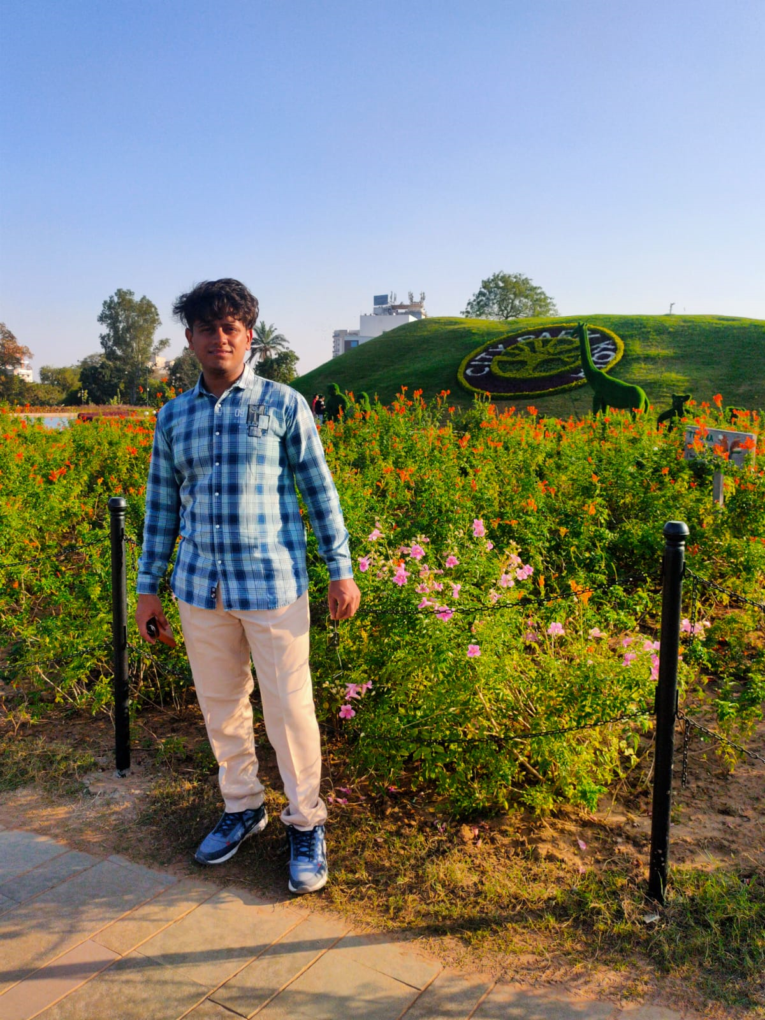
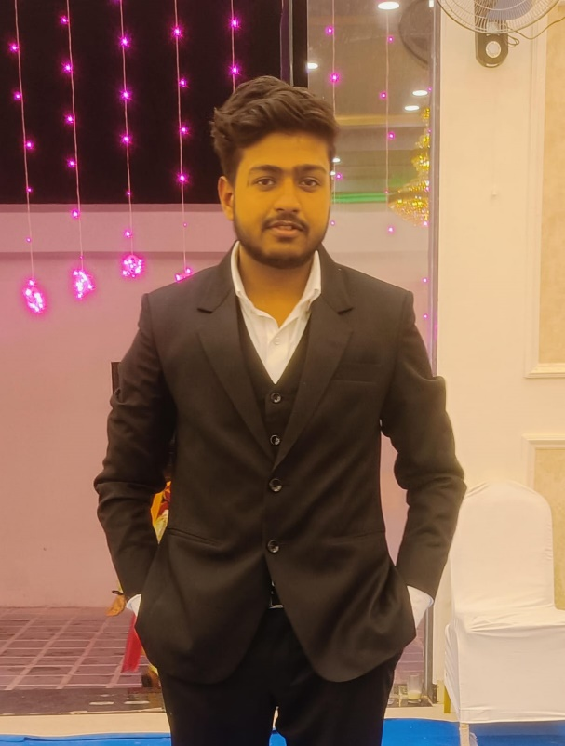
Team Composition
Ujesh Sisodia
Hitendra Sisodia
Rohit Gupta
What makes us a good team to solve the problem we chose?
We have genuine passion for supporting local artisans and businesses adds a personal touch to the project, driving the team's commitment and dedication. Our diverse skill set, industry knowledge, focus on innovation, collaborative spirit, passion for sustainability, and user-centric approach make us a cohesive and effective team ready to create a positive impact on campus commuting. We have done a thorough understanding of the local commerce market, including the challenges faced by artisans and customers, enables your team to tailor solutions effectively. The thing which makes us a good team for solving a problem is the ability to learn anything new and working with new technologies. Through this project we have achieve Strong Collaboration Skills.
Role/Position:
CEO
Role/Position:
COO/CTO
Role/Position:
CFO/CMO
Key Strengths and abilities
Visionary leadership
Strategic planning
Stakeholder management
Key Strengths and abilities
Operational excellence
Technology expertise
Innovation and system
optimization
Key Strengths and abilities
Financial management
Marketing strategy
Revenue generation
and optimization

Slide 23
Thank You!

